Slide 1
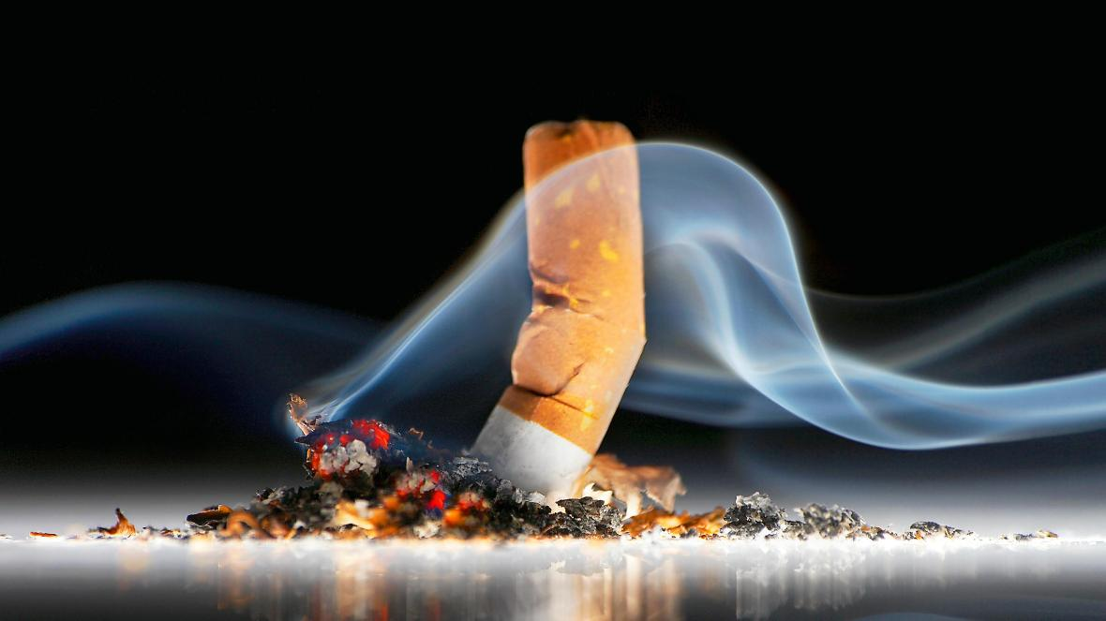
Phase I: Reduction of Cigarette Butts
Team Members:
Krishna Khadka,
Rozan Lamichhane,
Bishal Shrestha,
Nabin Shrestha,
Manish Khadka
Professor:- Bhanu Jain
TA:- Ariella Amanuel , Donna Safaddin
Course:- CSE 3330-001
Group:- 2

Slide 2
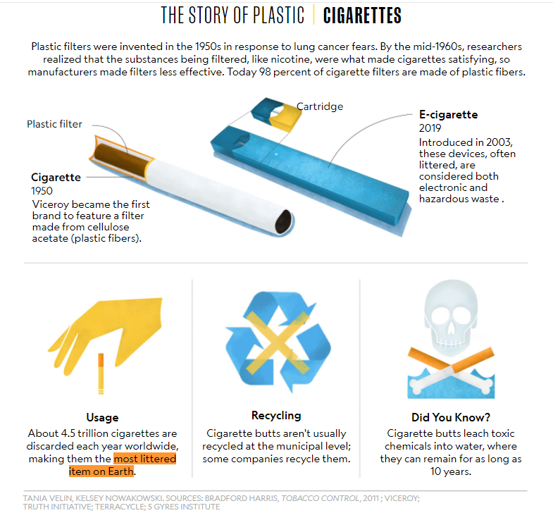
Why Cigarette Butt?
Filters are made of cellulose acetate- a natural plastic
Takes around 10 year for cellulose acetate to decay
5.7 Trillion of cigarettes are smoke annually - two thirds are improperly disposed of. [1]
65% of plastic butts are littered every year, could fill 1,431 Olympic sized swimming pools [1]
32 % of marine debris items contains cigarettes and filets which counts to 52.9 million. [2]

Slide 3
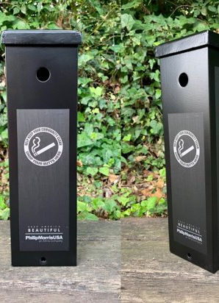
CLEAN FILTER
Operates in Arlington
Objective: Reduce cigarette butts in land and water thereby reducing trash
Company also keep track of the cigarette butt collected over time
It also helps companies manufacturing cigarettes to move to producing plastic free filters by providing the data and showing how they can profit from it while helping the environment get better.
Place cigarette butt collectors in numerous places and take weekly data for progress
Offers to provide a way to reduce nonbiodegradable trash created by cigarette butt providing wooden filters cigarette produced by Smokey Treats which is decomposable.
Photo credit: https://fredericksburg.today/2019/06/17/fredericksburg-parks-get-new-cigarette-butt-disposal-containers/

Slide 4
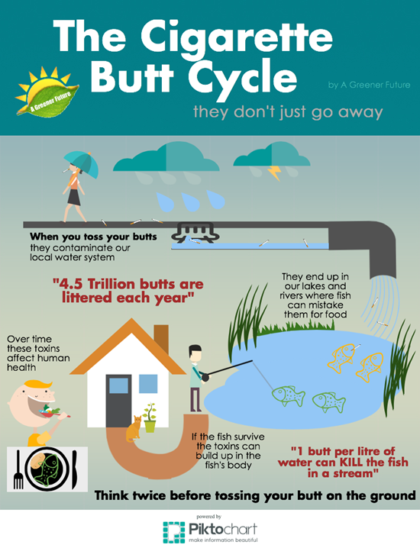
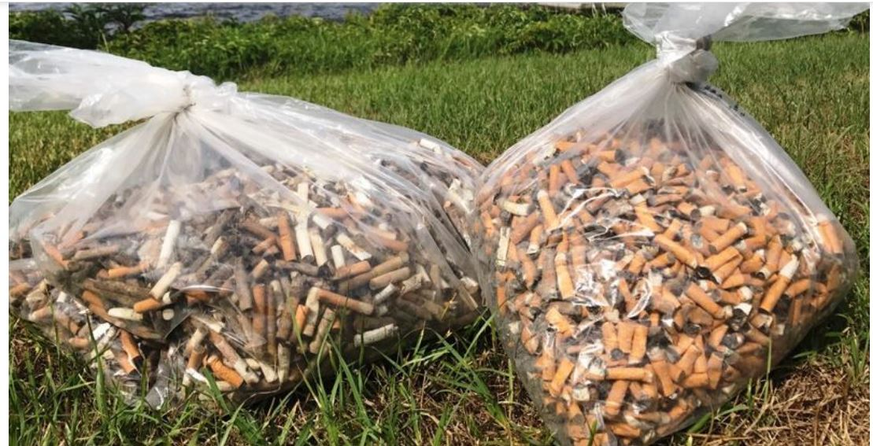

Slide 5
GreenButts (Competitor)
Location: California
Aim: Reduce Trash Caused By Cigarette Butt and Preserve Environment.
Literate People with potential risk of smoking and throwing cigarette butt.
Educate people about the money they save if they quit smoking.
Provide Alternative Cigarette Butt that reduce the environment pollution.
Operation Area: USA

Slide 6
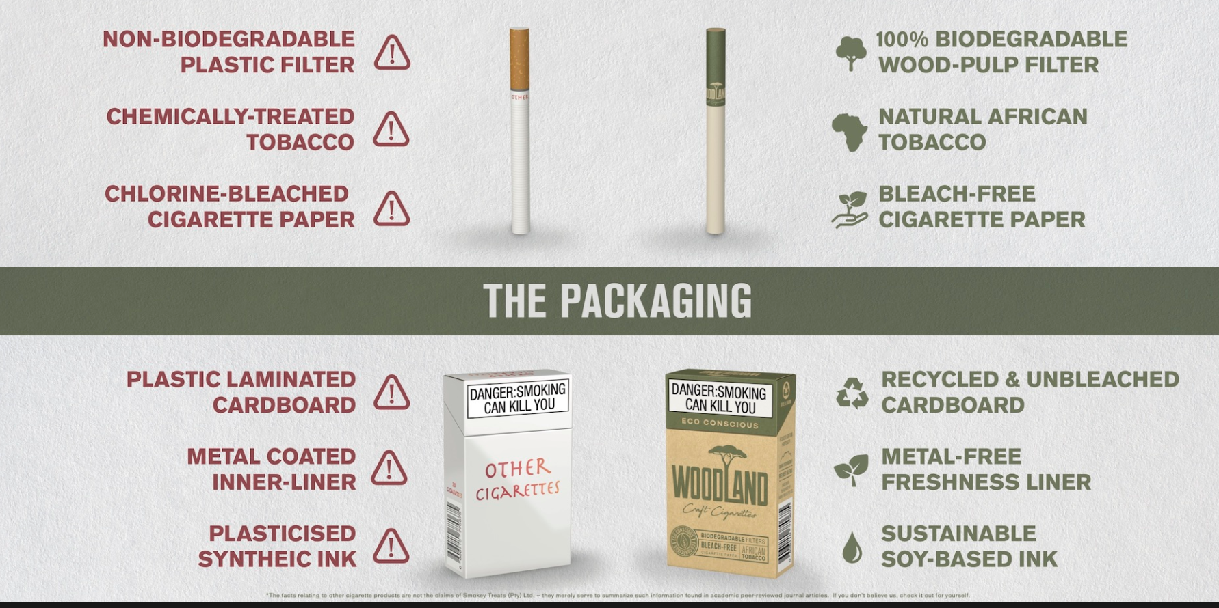
Collaborator Smokey Treats
Cape Town (2015)
provide smokers with
cigarette butt that is biodegradable.
Picture Credit:- smokeytreat.com

Slide 7
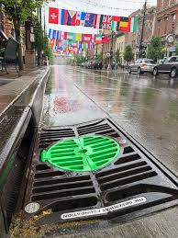
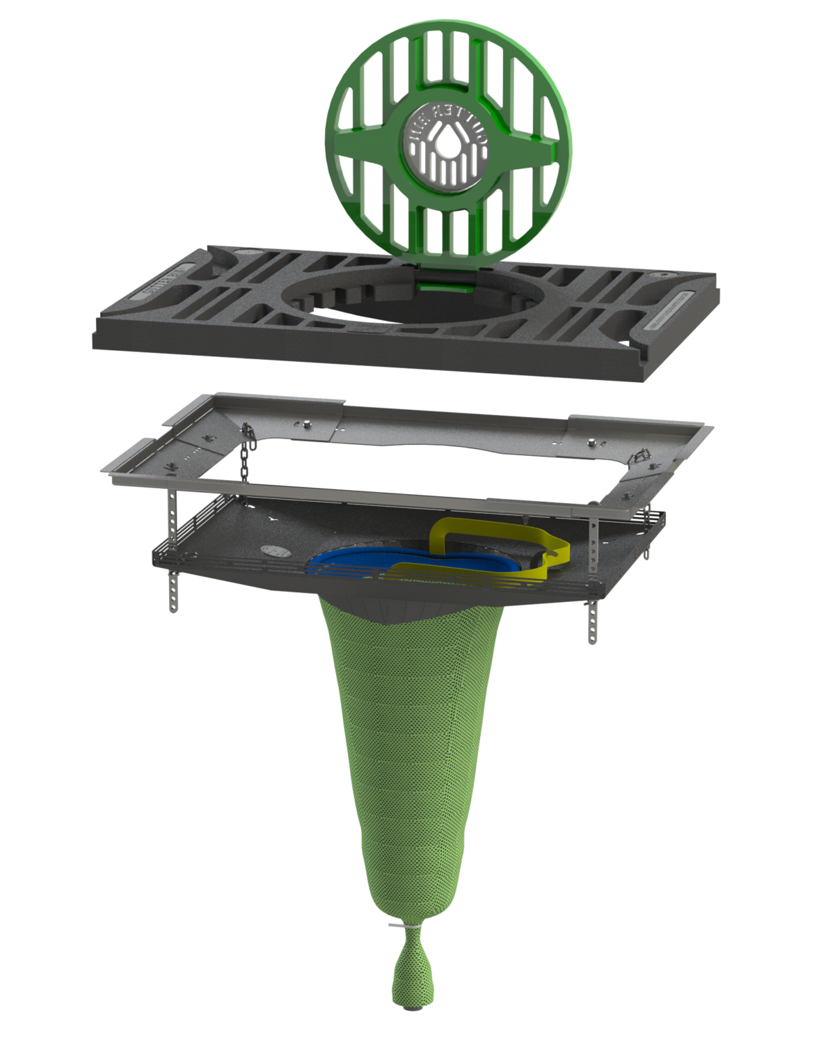
Collaborator
Frog Creek Partners
Founded in 2016
located in Casper, Wyoming
Working to Safeguard water with Stormwater filtration system[3]
fILTERS POLLUTANT BEFORE REACHING WATERSHEDS
Photo Credit: https://www.pinterest.com/pin/241013017546797418/
Photo Credit: https://frogcreek.partners/original-gutter-bin/
Notes:
Working with government contractors and sucessfully installed and in operation in Sheridian, WY
- founded by Brian Duerloo
- easy installation and fixing

Slide 8
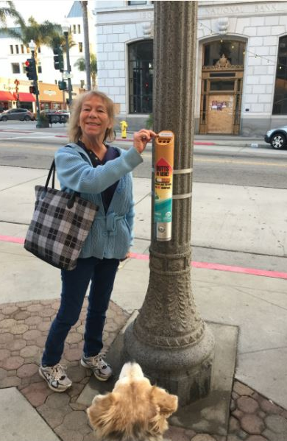
Our Tasks
Collaborate with big Cigarette companies to Set up Butt-Bins around major cities
Keep track of the Cigarette Butt collected
Keep track of money people save if they quit smoking
Keep track of the amount of cigarette butt disposed to ocean to aware people
Butt bins will reduce cigarette litter by more than 60 percent
Notes:
We as a company define our tasks to

Slide 9
Impacts of our company in the environment
Reduction in the number of cigarette butt thrown away that pollutes the environment
Help and motivate people to quit smoking for their health and financial stability
Consumer and their family health
Clean environment controlling the litter caused by cigarette butt
Save aquatic lives
Reduction of disposition of harmful chemicals due to cigarette butt

Slide 10
How we finance our company?
Support through the collaboration with smokey treats
Proposing our idea to the cities and helping cities save money on personnel by keeping bin around the cities
Accepting donations
Accept volunteers to count/weigh the butts collected in the bin to update our database, and to empty the bins in timely manner.

Slide 11
Reference
[1] https://smokeytreats.co.za/the-problem/
[2] https://theconversation.com/cigarette-butts-are-the-forgotten-plastic-pollution-and-they-could-be-killing-our-plants-119958
[3] https://frogcreek.partners/
For Images:- shutterstock.com
https://www.green-butts.com/
https://smokeytreats.co.za/

